Slide 1
G.H.RAISONI COLLEGE OF ENGINEERING AND MANAGEMENT
Session 2020-21
Presentation on
“Linear Regression”
By
Soham Yugraj Tiwari
Amaan Ayyub Nalband
Shravan Vijaypratap Singh
Pratik Rajesh Jade
(Roll no’s A69, A70, A71, A72)
Faculty Name: Ms Padmavati Sarode
FY B.Tech: Div A

Slide 2
Linear Regression

Slide 3
What is Regression?
Formulation of a functional relationship between a set of Independent or Explanatory variables (X’s) with a Dependent or Response variable (Y).
Y = f(X)
Why Regression?
Knowledge of Y is crucial for decision making.
• Will he/she buy or not?
• Shall I offer him/her the loan or not?
X is available at the time of decision making and is related to Y, thus making it possible to have a prediction of Y.

Slide 4
Types of Linear Regression
Simple Linear Regression
Multiple Linear Regression

Slide 5
Simple Linear Regression
In statistics, simple linear regression is a linear regression model with a single explanatory variable.
Simple linear regression is a statistical method that allows us to summarize and study relationships between two continuous (quantitative) variables:
One variable, denoted x, is regarded as the predictor, explanatory, or independent variable.
The other variable, denoted y, is regarded as the response, outcome, or dependent variable.
A linear regression line has an equation of the form Y = a + bX, where X is the explanatory variable and Y is the dependent variable. The slope of the line is b, and a is the intercept (the value of y when x = 0).

Slide 6
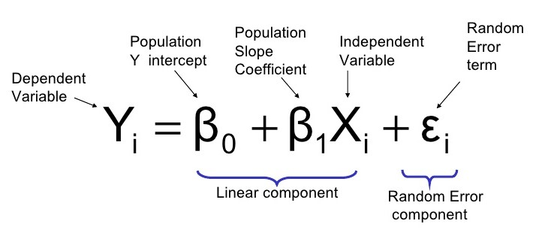
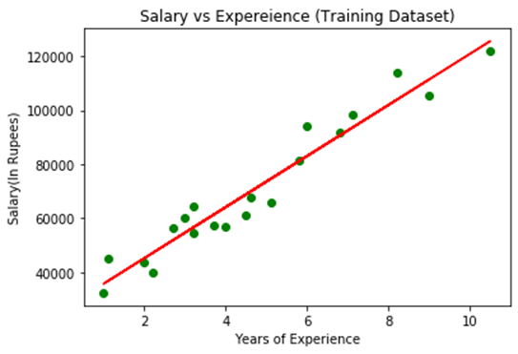
Model of Simple Linear Regression
Example:

Slide 7
Multiple Linear Regression
Multiple linear regression is used to estimate the relationship between two or more independent variables and one dependent variable.
You can use multiple linear regression when you want to know:
How strong the relationship is between two or more independent variables and one dependent variable (e.g. how rainfall, temperature, and amount of fertilizer added affect crop growth).
The value of the dependent variable at a certain value of the independent variables (e.g. the expected yield of a crop at certain levels of rainfall, temperature, and fertilizer addition).

Slide 8
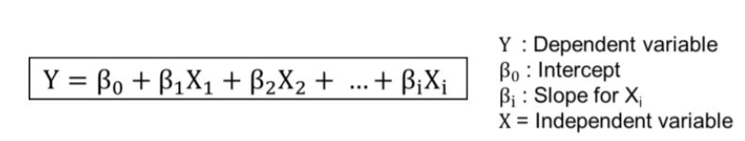
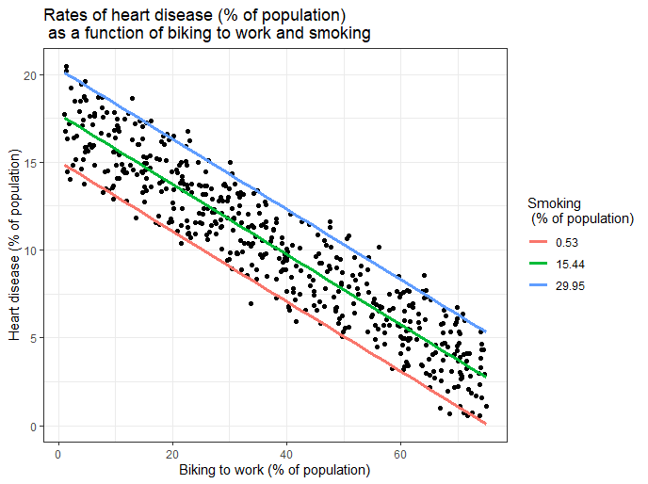
Model of Multiple Linear Regression
Example:

Slide 9
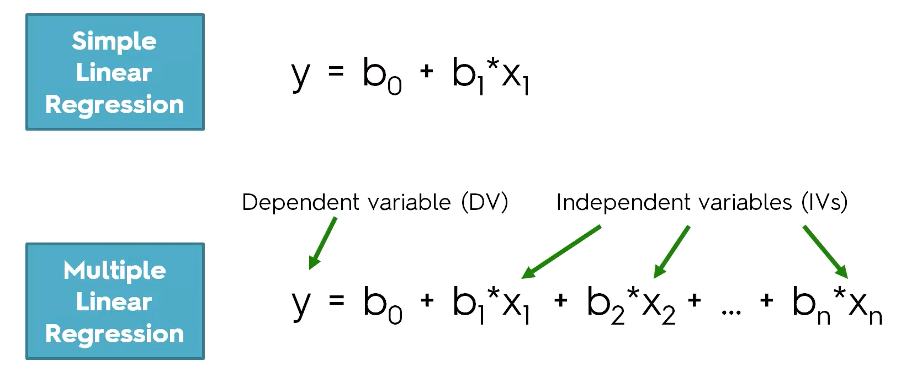
Equations of Linear Regression

Slide 10
OLS Regression Properties
The sum of the residuals from the least squares regression line is zero. ∑ ( y −yˆ) = 0
The sum of the squared residuals is a minimum. (minimize∑ ( y −yˆ) ).
The simple regression line always passes through the mean of the y variable and the mean of the x variable
The least squares coefficients are unbiased estimates of β0 and β1

Slide 11
Limitations of Regression Analysis
Parameter Instability - This happens in situations where correlations change over a period of time. This is very common in financial markets where economic, tax, regulatory, and political factors change frequently.
• Public knowledge of a specific regression relation may cause a large number of people to react in a similar fashion towards the variables, negating its future usefulness.
• If any of the regression assumptions are violated, predicted dependent variables and hypothesis tests will not hold valid.

Slide 12
Example
input
 | OrderDate | Region | Rep | Item | Units | Unit Cost | Total
 | 9-1-14 | Central | Smith | Desk | 2 | 125.00 | 250.00
 | 6-17-15 | Central | Kivell | Desk | 5 | 125.00 | 625.00
 | 9-10-15 | Central | Gill | Pencil | 7 | 1.29 | 9.03
 | 11-17-15 | Central | Jardine | Binder | 11 | 4.99 | 54.89
 | 10-31-15 | Central | Andrews | Pencil | 14 | 1.29 | 18.06
 | 2-26-14 | Central | Gill | Pen | 27 | 19.99 | 539.73
 | 10-5-14 | Central | Morgan | Binder | 28 | 8.99 | 251.72
 | 12-21-15 | Central | Andrews | Binder | 28 | 4.99 | 139.72
 | 2-9-14 | Central | Jardine | Pencil | 36 | 4.99 | 179.64
 | 8-7-15 | Central | Kivell | Pen Set | 42 | 23.95 | ########
 | 1-15-15 | Central | Gill | Binder | 46 | 8.99 | 413.54
 | 1-23-14 | Central | Kivell | Binder | 50 | 19.99 | 999.50
 | 3-24-15 | Central | Jardine | Pen Set | 50 | 4.99 | 249.50
 | 5-14-15 | Central | Gill | Pencil | 53 | 1.29 | 68.37
 | 7-21-15 | Central | Morgan | Pen Set | 55 | 12.49 | 686.95
 | 4-10-15 | Central | Andrews | Pencil | 66 | 1.99 | 131.34
 | 12-12-14 | Central | Smith | Pencil | 67 | 1.29 | 86.43
 | 4-18-14 | Central | Andrews | Pencil | 75 | 1.99 | 149.25
 | 5-31-15 | Central | Gill | Binder | 80 | 8.99 | 719.20
 | 2-1-15 | Central | Smith | Binder | 87 | 15.00 | ########
 | 5-5-14 | Central | Jardine | Pencil | 90 | 4.99 | 449.10
 | 6-25-14 | Central | Morgan | Pencil | 90 | 4.99 | 449.10
 | 12-4-15 | Central | Jardine | Binder | 94 | 19.99 | ########
 | 11-25-14 | Central | Kivell | Pen Set | 96 | 4.99 | 479.04
 | 2-18-15 | East | Jones | Binder | 4 | 4.99 | 19.96
 | 11-8-14 | East | Parent | Pen | 15 | 19.99 | 299.85
 | 9-18-14 | East | Jones | Pen Set | 16 | 15.99 | 255.84
 | 7-12-14 | East | Howard | Binder | 29 | 1.99 | 57.71
 | 8-15-14 | East | Jones | Pencil | 35 | 4.99 | 174.65
 | 4-1-14 | East | Jones | Binder | 60 | 4.99 | 299.40
 | 6-8-14 | East | Jones | Binder | 60 | 8.99 | 539.40
 | 7-4-15 | East | Jones | Pen Set | 62 | 4.99 | 309.38
 | 10-22-14 | East | Jones | Pen | 64 | 8.99 | 575.36
 | 12-29-14 | East | Parent | Pen Set | 74 | 15.99 | ########
 | 7-29-14 | East | Parent | Binder | 81 | 19.99 | ########
 | 1-6-14 | East | Jones | Pencil | 95 | 1.99 | 189.05
 | 4-27-15 | East | Howard | Pen | 96 | 4.99 | 479.04
 | 8-24-15 | West | Sorvino | Desk | 3 | 275.00 | 825.00
 | 3-7-15 | West | Sorvino | Binder | 7 | 19.99 | 139.93
 | 5-22-14 | West | Thompson | Pencil | 32 | 1.99 | 63.68
 | 3-15-14 | West | Sorvino | Pencil | 56 | 2.99 | 167.44
 | 10-14-15 | West | Thompson | Binder | 57 | 19.99 | ########
 | 9-27-15 | West | Sorvino | Pen | 76 | 1.99 | 151.24
output
 | SUMMARY OUTPUT
 | Regression Statistics
 | Multiple R | 0.392016
 | R Square | 0.153677
 | Adjusted R Square | 0.133035
 | Standard Error | 28.00615
 | Observations | 43
 | ANOVA
 |  | df | SS | MS | F | Significance F
 | Regression | 1 | 5839.325 | 5839.325 | 7.444849 | 0.009326
 | Residual | 41 | 32158.12 | 784.3443
 | Total | 42 | 37997.44
 |  | Coefficients | Standard Error | t Stat | P-value | Lower 95% | Upper 95% | Lower 95.0% | Upper 95.0%
 | Intercept | 54.38338 | 4.655822 | 11.68073 | 1.27E-14 | 44.98076 | 63.786 | 44.98076 | 63.786
 | X Variable 1 | -0.24905 | 0.091275 | -2.72853 | 0.009326 | -0.43338 | -0.06471 | -0.43338 | -0.06471
 | RESIDUAL OUTPUT |  |  |  | PROBABILITY OUTPUT
 | Observation | Predicted Y | Residuals |  | Percentile | Y
 | 1 | 23.25249 | -21.2525 |  | 1.162791 | 2
 | 2 | 23.25249 | -18.2525 |  | 3.488372 | 3
 | 3 | 54.06211 | -47.0621 |  | 5.813953 | 4
 | 4 | 53.14064 | -42.1406 |  | 8.139535 | 5
 | 5 | 54.06211 | -40.0621 |  | 10.46512 | 7
 | 6 | 49.40493 | -22.4049 |  | 12.7907 | 7
 | 7 | 52.14445 | -24.1444 |  | 15.11628 | 11
 | 8 | 53.14064 | -25.1406 |  | 17.44186 | 14
 | 9 | 53.14064 | -17.1406 |  | 19.76744 | 15
 | 10 | 48.4187 | -6.4187 |  | 22.09302 | 16
 | 11 | 52.14445 | -6.14445 |  | 24.4186 | 27
 | 12 | 49.40493 | 0.595071 |  | 26.74419 | 28
 | 13 | 53.14064 | -3.14064 |  | 29.06977 | 28
 | 14 | 54.06211 | -1.06211 |  | 31.39535 | 29
 | 15 | 51.27278 | 3.727218 |  | 33.72093 | 32
 | 16 | 53.88778 | 12.11222 |  | 36.04651 | 35
 | 17 | 54.06211 | 12.93789 |  | 38.37209 | 36
 | 18 | 53.88778 | 21.11222 |  | 40.69767 | 42
 | 19 | 52.14445 | 27.85555 |  | 43.02326 | 46
 | 20 | 50.64767 | 36.35233 |  | 45.34884 | 50
 | 21 | 53.14064 | 36.85936 |  | 47.67442 | 50
 | 22 | 53.14064 | 36.85936 |  | 50 | 53
 | 23 | 49.40493 | 44.59507 |  | 52.32558 | 55
 | 24 | 53.14064 | 42.85936 |  | 54.65116 | 56
 | 25 | 53.14064 | -49.1406 |  | 56.97674 | 57
 | 26 | 49.40493 | -34.4049 |  | 59.30233 | 60
 | 27 | 50.40112 | -34.4011 |  | 61.62791 | 60
 | 28 | 53.88778 | -24.8878 |  | 63.95349 | 62
 | 29 | 53.14064 | -18.1406 |  | 66.27907 | 64
 | 30 | 53.14064 | 6.859365 |  | 68.60465 | 66
 | 31 | 52.14445 | 7.855553 |  | 70.93023 | 67
 | 32 | 53.14064 | 8.859365 |  | 73.25581 | 74
 | 33 | 52.14445 | 11.85555 |  | 75.5814 | 75
 | 34 | 50.40112 | 23.59888 |  | 77.90698 | 76
 | 35 | 49.40493 | 31.59507 |  | 80.23256 | 80
 | 36 | 53.88778 | 41.11222 |  | 82.55814 | 81
 | 37 | 53.14064 | 42.85936 |  | 84.88372 | 87
 | 38 | -14.1046 | 17.10457 |  | 87.2093 | 90
 | 39 | 49.40493 | -42.4049 |  | 89.53488 | 90
 | 40 | 53.88778 | -21.8878 |  | 91.86047 | 94
 | 41 | 53.63873 | 2.36127 |  | 94.18605 | 95
 | 42 | 49.40493 | 7.595071 |  | 96.51163 | 96
 | 43 | 53.88778 | 22.11222 |  | 98.83721 | 96
Input:
Output:

Slide 13
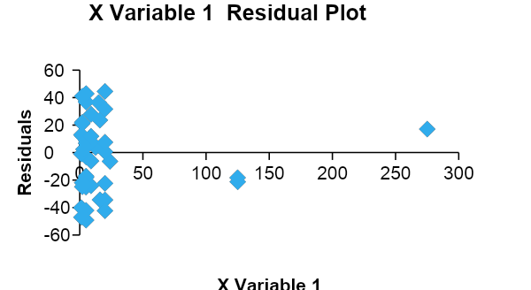
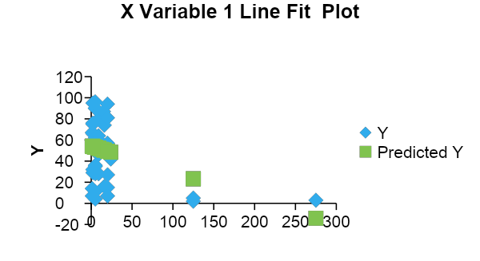
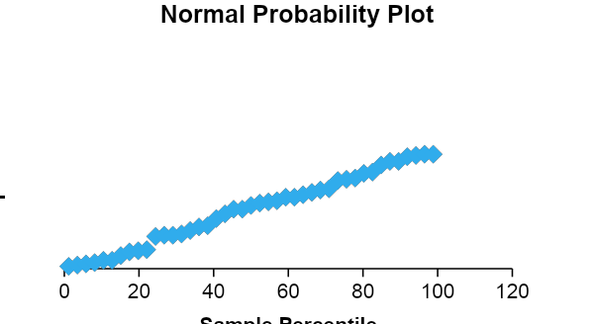
Continued:

Slide 14
Thank
You...

